Slide 1
AWS Serverless Application Model
Lecturer: Ngo Huy Bien
Software Engineering Department
Faculty of Information Technology
University of Science
Ho Chi Minh City, Vietnam
nhbien@fit.hcmus.edu.vn

Slide 2

Objectives

Slide 3

Contents

Slide 4

References

Slide 5
AWS Serverless Application Model
https://docs.aws.amazon.com/serverless-application-model/
The AWS Serverless Application Model (AWS SAM) is an open-source framework that enables you to build serverless applications on AWS.
It provides you with
a template specification to define your serverless application, and
a command line interface (CLI) tool.

Slide 6
AWS SAM Template Specification
https://docs.aws.amazon.com/serverless-application-model/latest/developerguide/what-is-sam.html
The AWS SAM template specification is an open-source framework that you can use to define and manage your serverless application infrastructure code.
The AWS SAM template specification is:
Built on AWS CloudFormation – Use the AWS CloudFormation syntax directly within your AWS SAM template.
An extension of AWS CloudFormation – AWS SAM offers its own unique syntax that focuses specifically on speeding up serverless development.

Slide 7
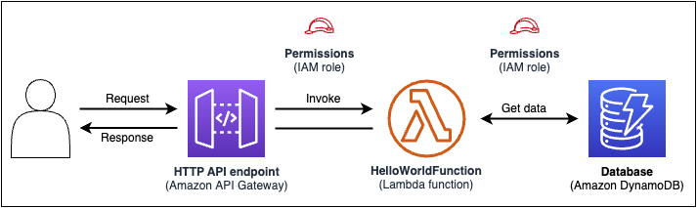
Example Application
A function that contains the logic to process the request.
An HTTP API to serve as communication between the client (requestor) and the application.
A database to store items.
Permissions for the application to run securely.

Slide 8
Example Template
The application's infrastructure code can be defined in the following AWS SAM template:
AWSTemplateFormatVersion: 2010-09-09
Transform: AWS::Serverless-2016-10-31
Resources:
getAllItemsFunction:
Type: AWS::Serverless::Function
Properties:
Handler: src/get-all-items.getAllItemsHandler
Runtime: nodejs12.x
Events:
Api:
Type: HttpApi
Properties:
Path: /
Method: GET
Connectors:
MyConn:
Properties:
Destination:
Id: SampleTable
Permissions:
- Read
SampleTable:
Type: AWS::Serverless::SimpleTable

Slide 9
AWS SAM CLI
The AWS SAM CLI is a command line tool that you can use with AWS SAM templates and supported third-party integrations to build and run your serverless applications.
Use the AWS SAM CLI to:
Quickly initialize a new application project.
Build your application for deployment.
Perform local debugging and testing.
Deploy your application.

Slide 10
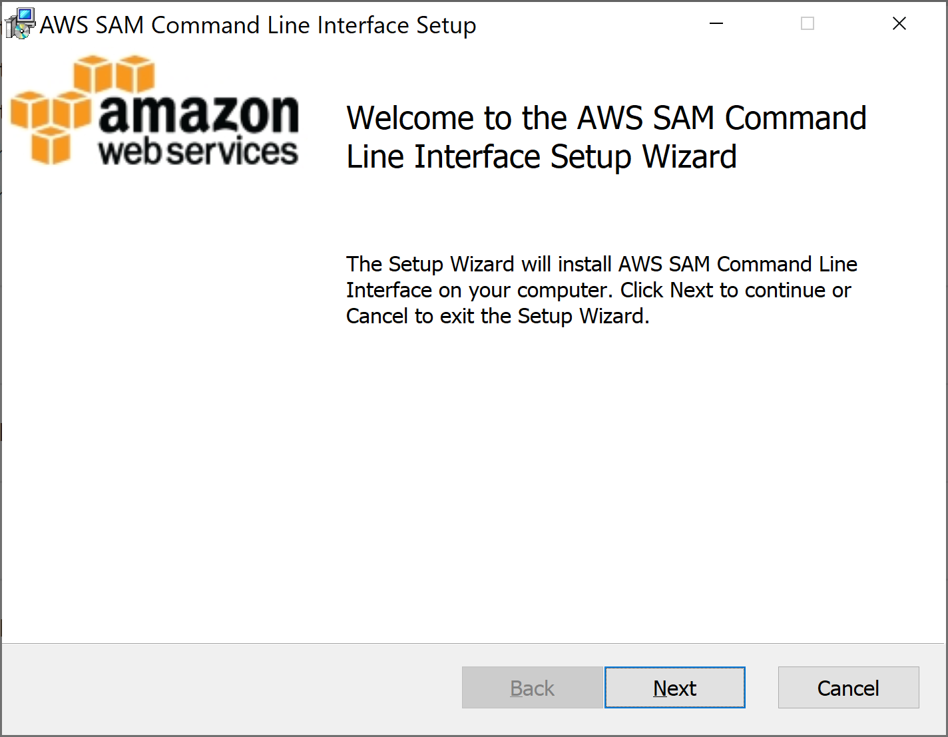
1. Install AWS SAM CLI
https://docs.aws.amazon.com/serverless-application-model/latest/developerguide/install-sam-cli.html

Slide 11
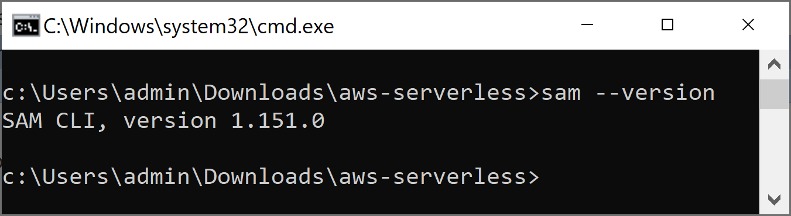
2. Verify AWS SAM CLI Installation
sam --version

Slide 12


Slide 13
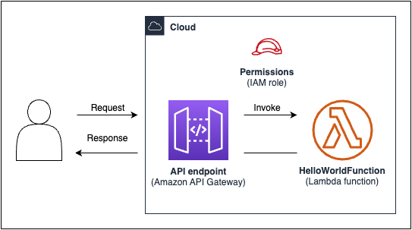
1. Introduce "Hello World" App
https://docs.aws.amazon.com/serverless-application-model/latest/developerguide/serverless-getting-started-hello-world.html

Slide 14
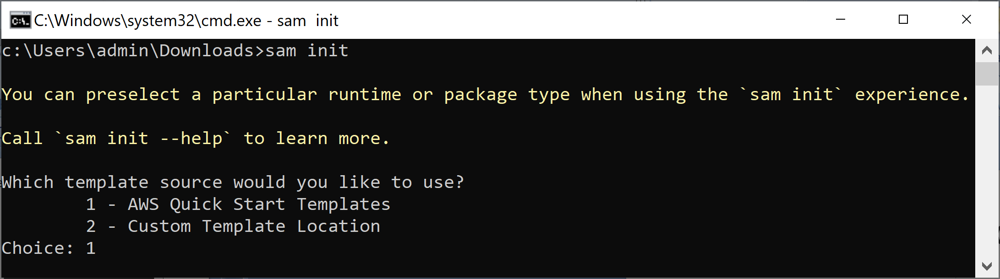
2. Initialize the App
sam init

Slide 15
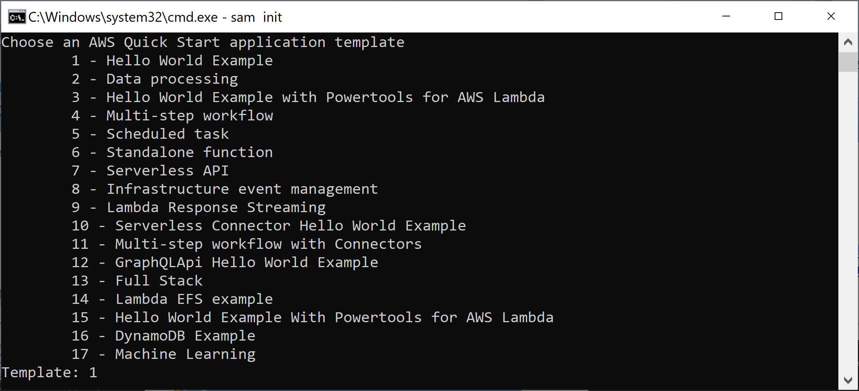
3. Select a Template

Slide 16
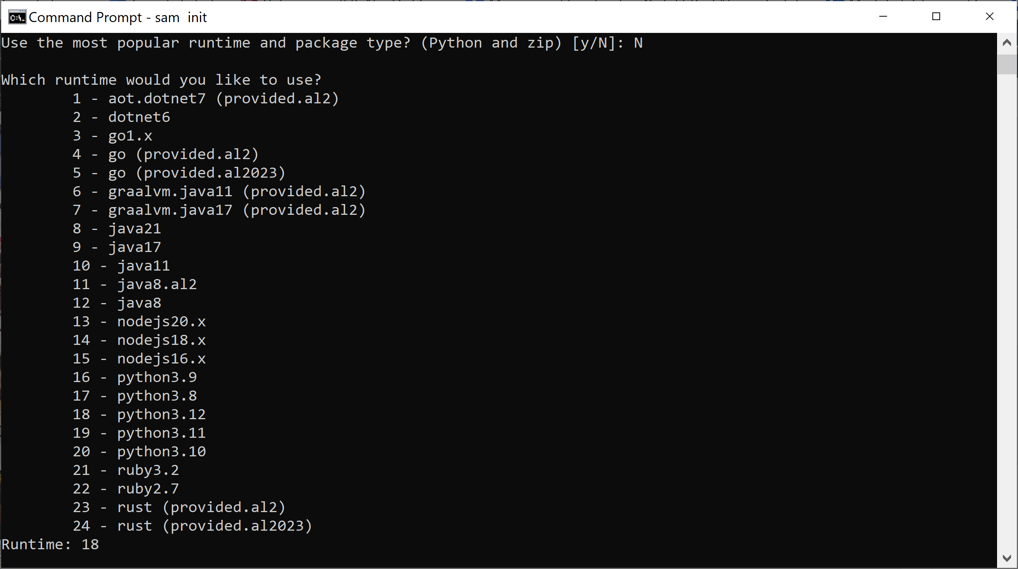
4. Select a Runtime

Slide 17
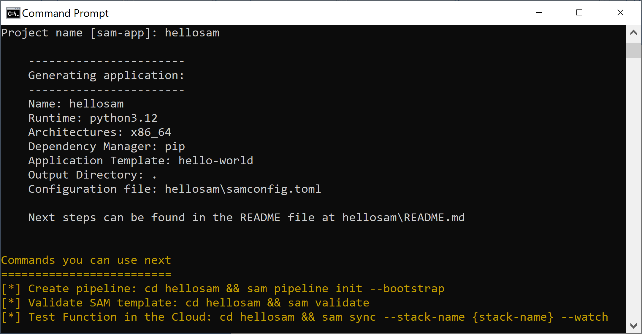
5. Review the Application Information

Slide 18
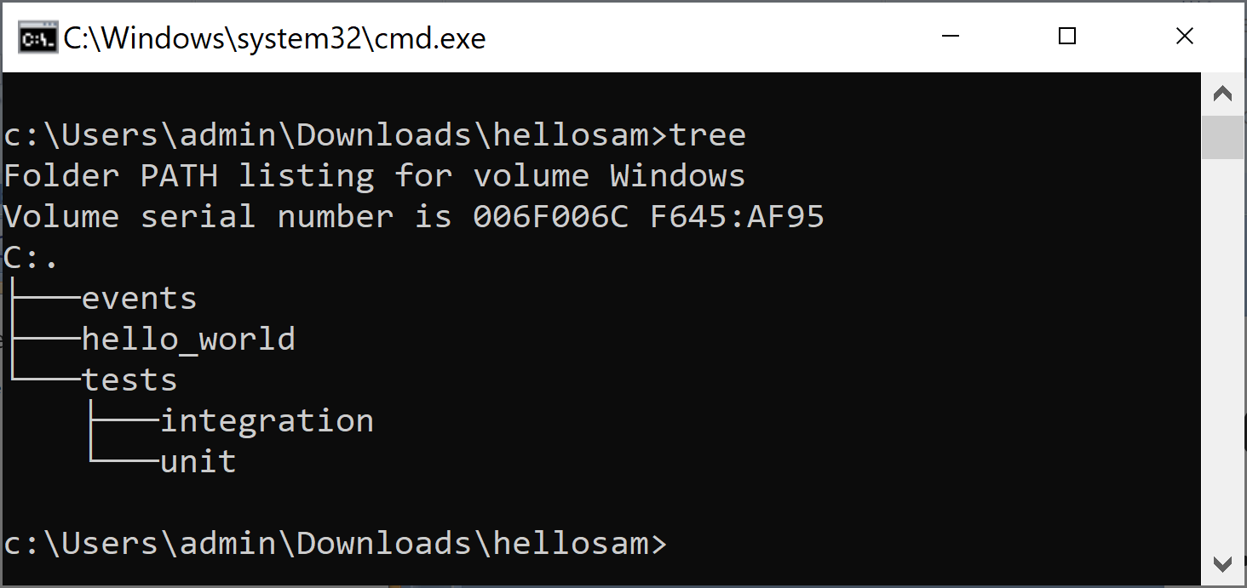
6. Review the Application Structure
cd hellosam
tree

Slide 19
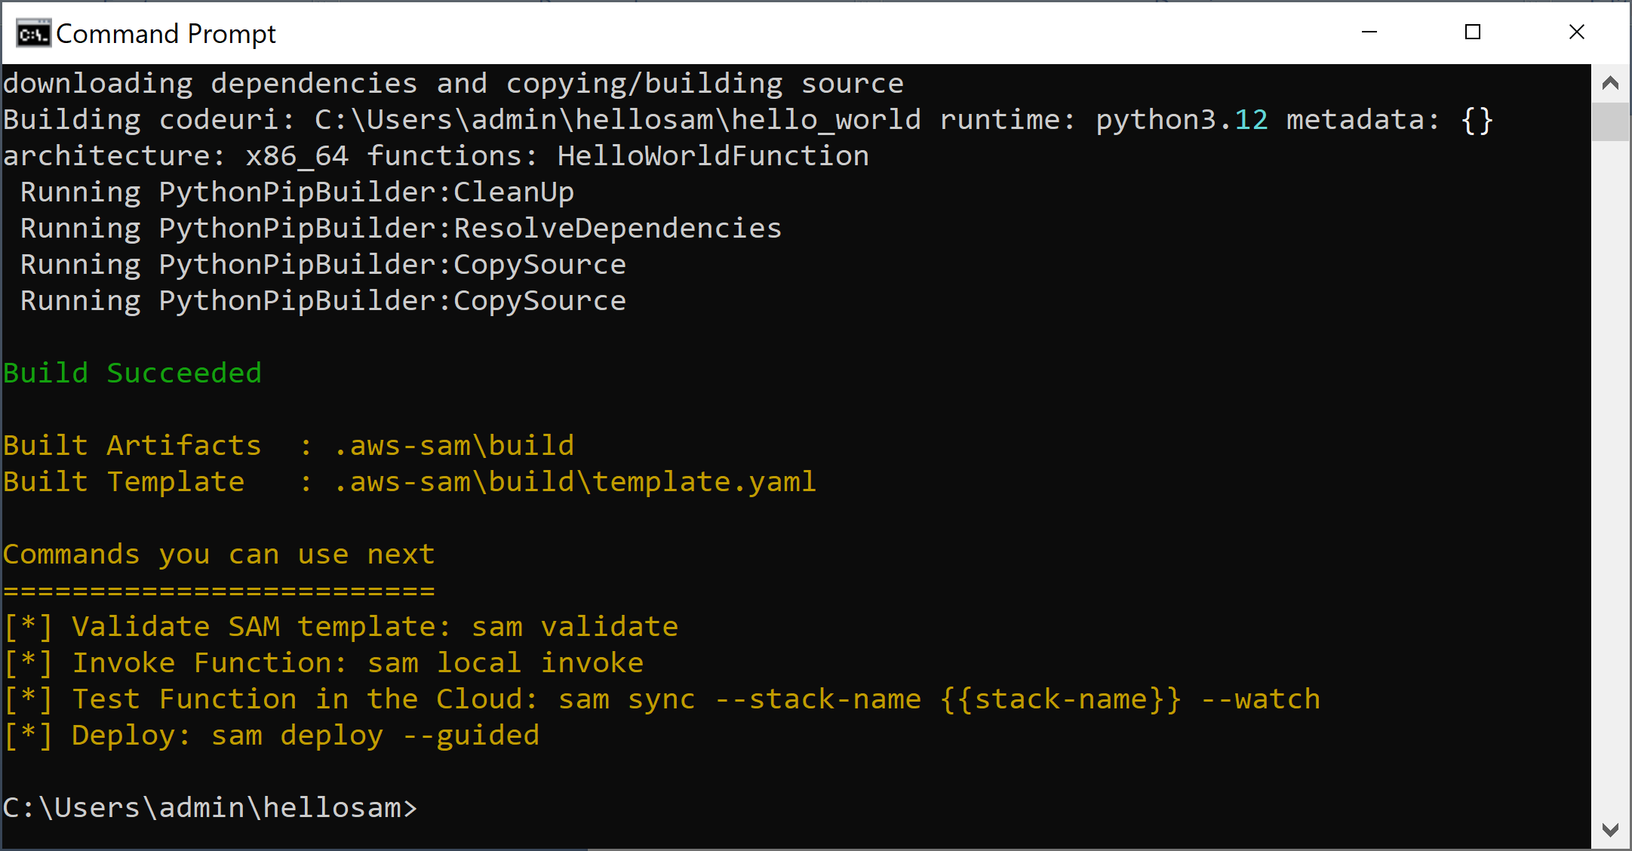
7. Build the Application
sam build

Slide 20
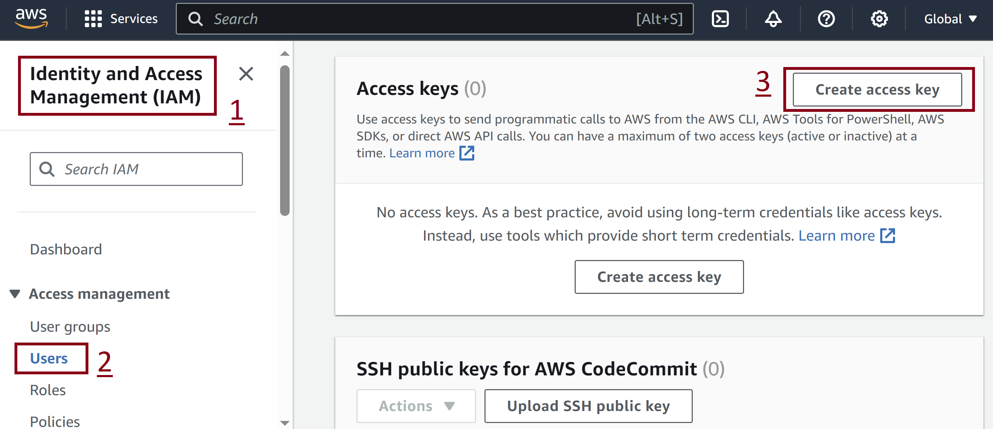
8. Create Access Key

Slide 21
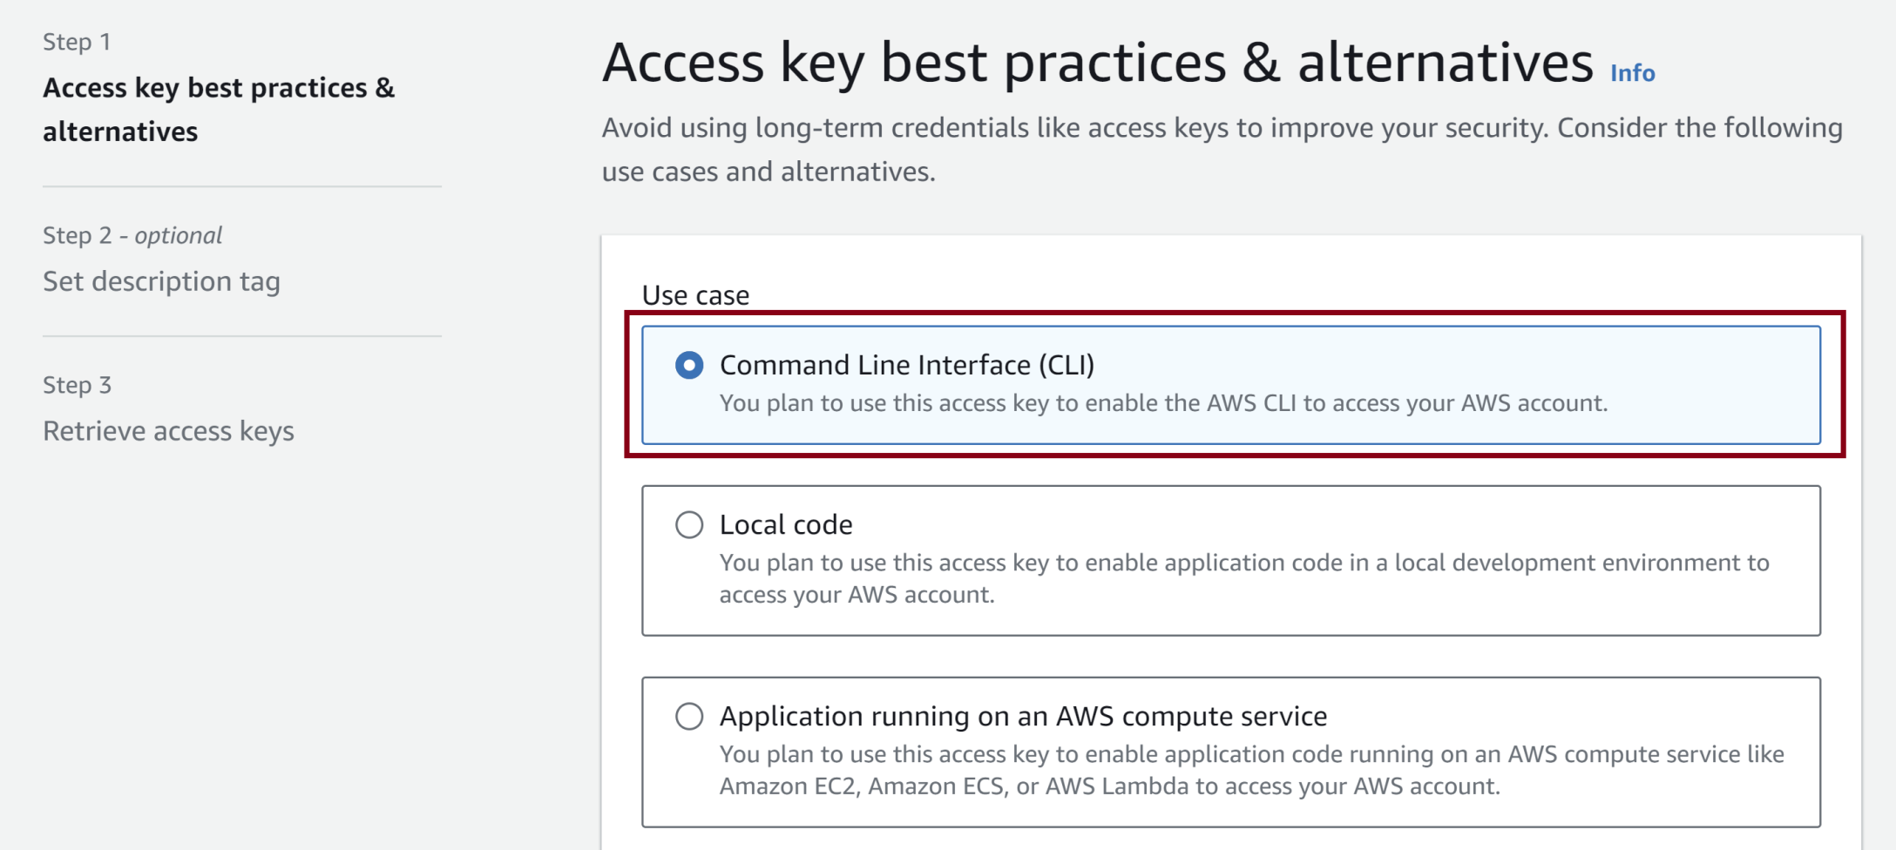
9. Select a Use Case

Slide 22
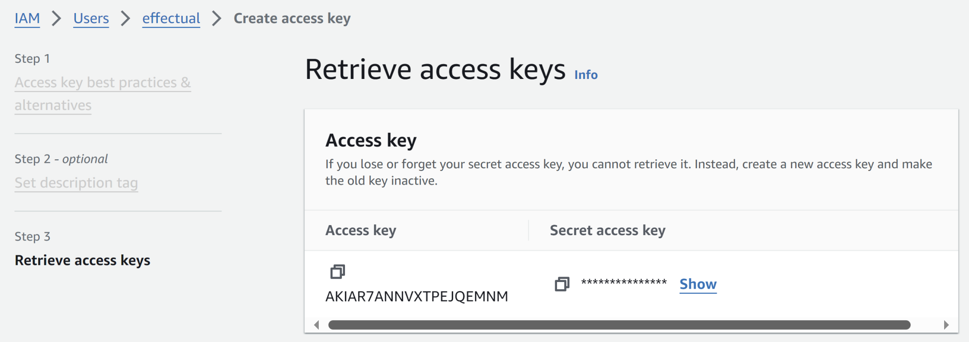
10. Store Access and Secret Key

Slide 23
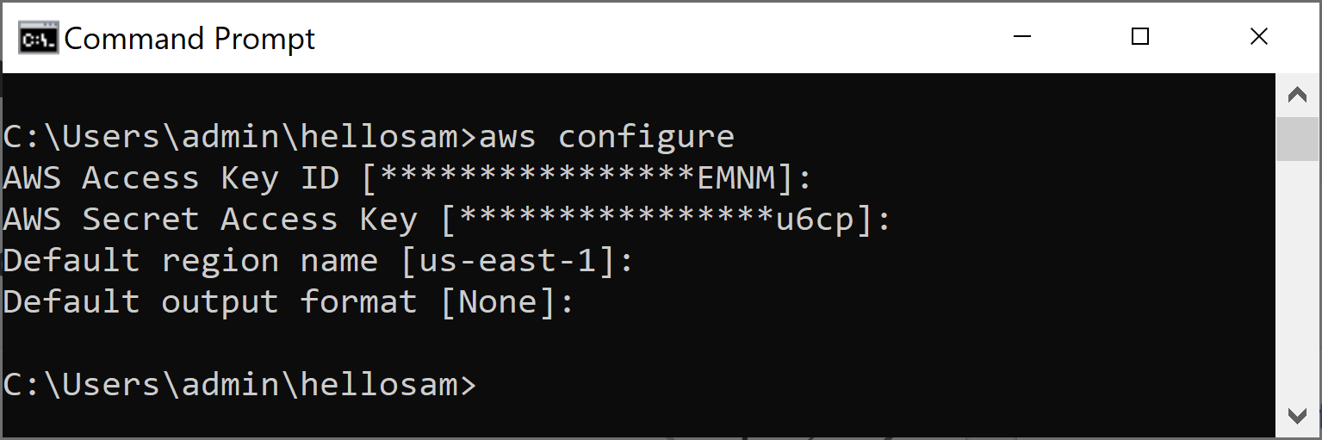
11. Configure AWS
aws configure

Slide 24
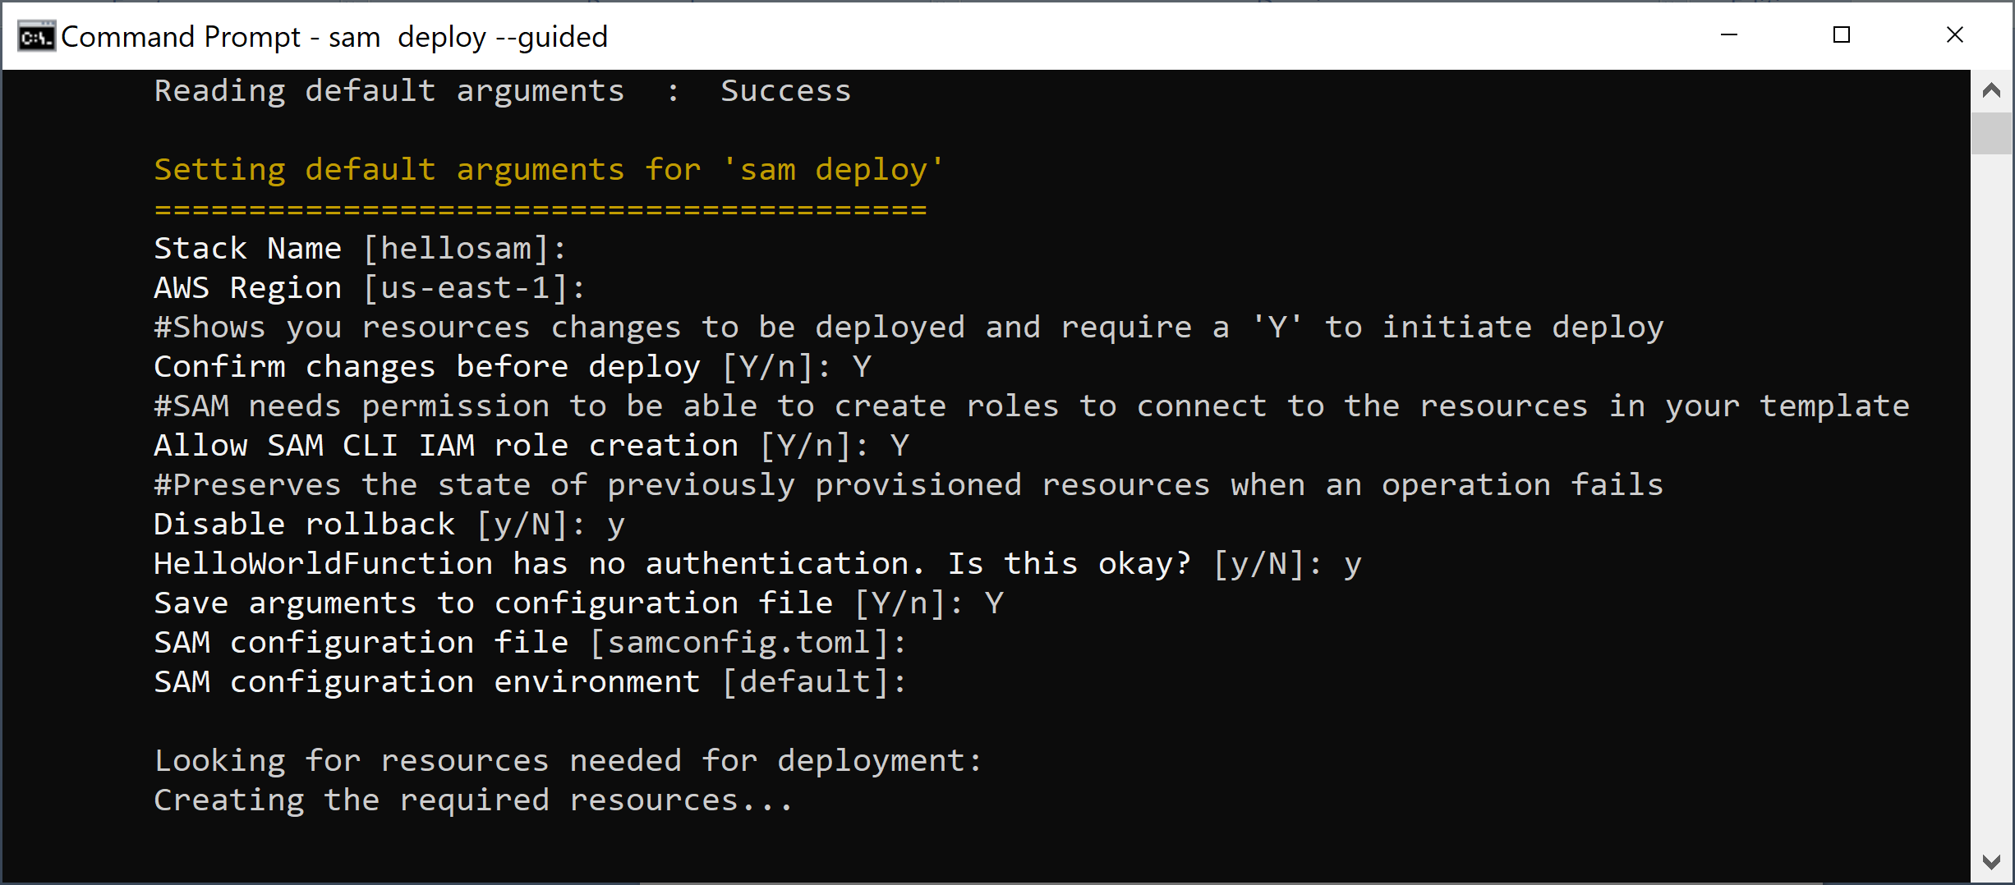
12. Deploy the Application
sam deploy --guided

Slide 25
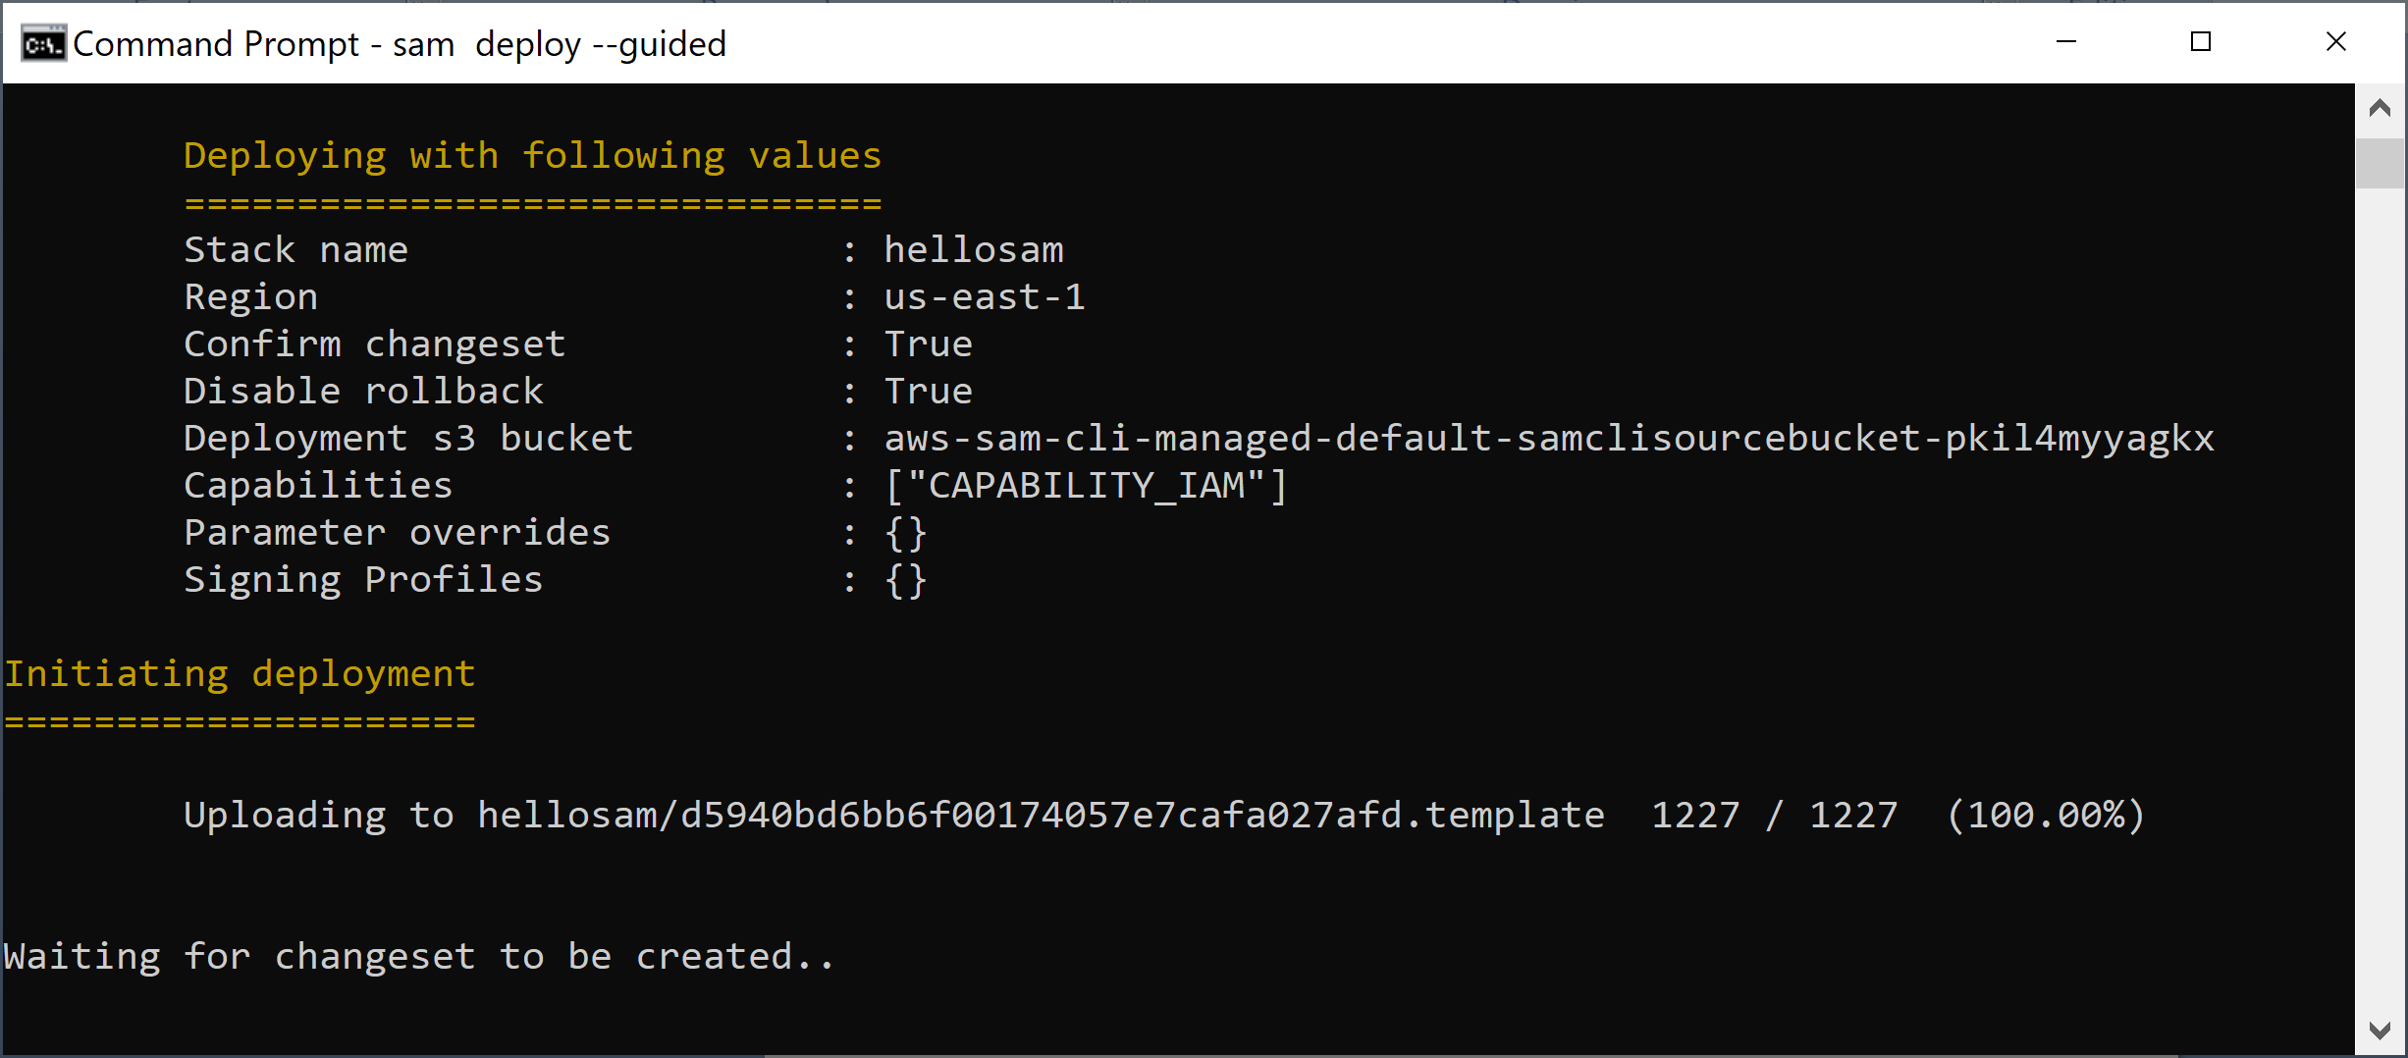
13. Review the Deployment Information

Slide 26
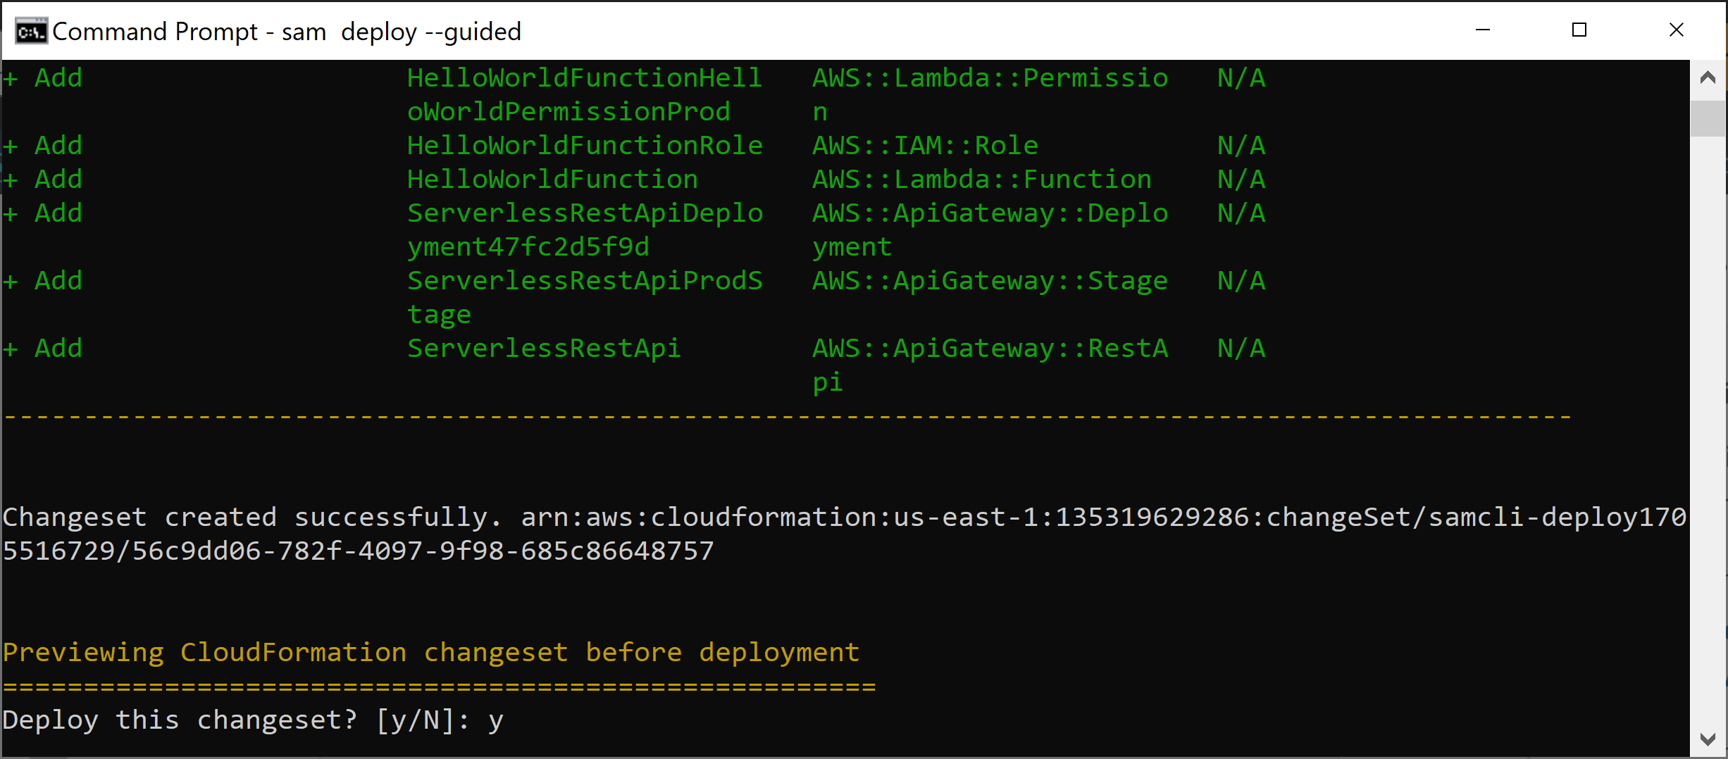
14. Confirm the Deployment

Slide 27
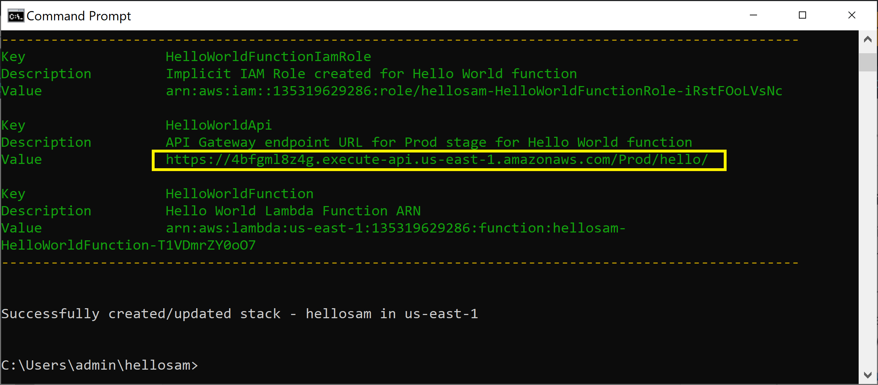
15. Review or Get the Endpoints
sam list endpoints --output json

Slide 28
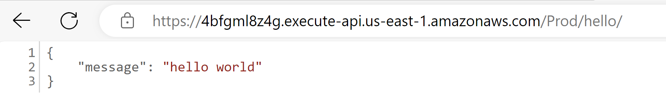
16. Test the App

Slide 29
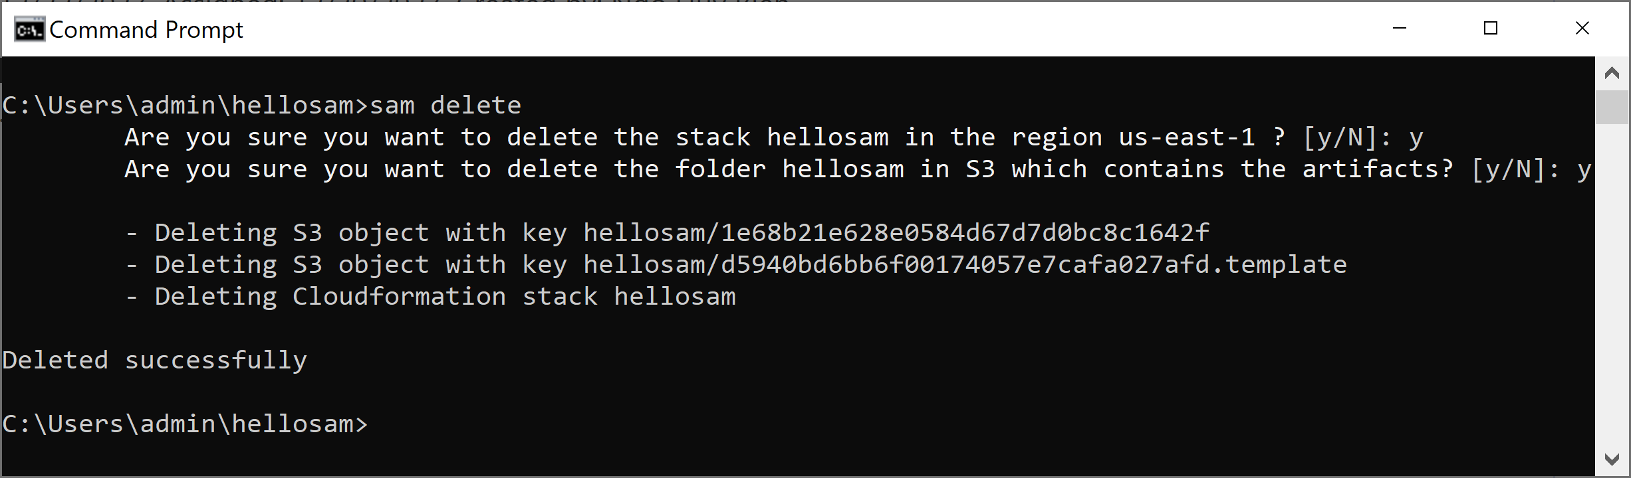
17. Delete the App
sam delete

Slide 30
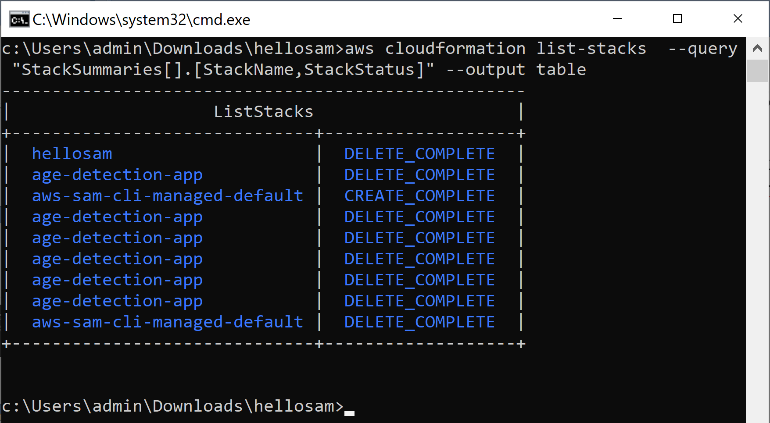
18. List all Stacks
aws cloudformation list-stacks --query "StackSummaries[].[StackName,StackStatus]" --output table

Slide 32
Manual Software Deployment
Fetch source code or binaries
Install dependencies
Edit configuration files
Start services

Slide 33
Why Automating Deployment?
To ensure high availability and scalability, you need to configure an Auto Scaling group to launch EC2 instances automatically. A new machine could spin up at any time, so deploying changes manually is not an option.
Manual changes are error prone and expensive to reproduce. Automating increases reliability and reduces the costs per deployment.

Slide 35
AWS Service Catalog
https://aws.amazon.com/servicecatalog/
Create, share, organize, and govern your curated IaC templates.
Why Service Catalog?
Create, organize, and govern a curated catalog of AWS resources that can be shared at the permissions level so you can quickly provision approved cloud resources without needing direct access to the underlying AWS services.
Service Catalog = "Company IT controls what users can launch"

Slide 37
1. Deploy the age detection app
aws s3 cp frontend/index.html s3://age-detection-app-frontend-135319629286/index.html
aws s3 cp frontend/favicon.ico s3://age-detection-app-frontend-135319629286/favicon.ico

Slide 38
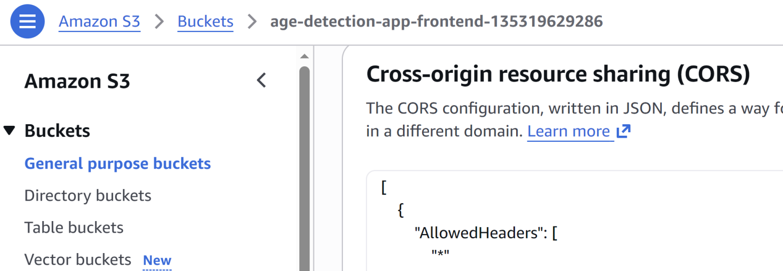
2. Enable CORS for S3 Bucket
[
{
"AllowedHeaders": [
"*"
],
"AllowedMethods": [
"GET",
"PUT",
"POST"
],
"AllowedOrigins": [
"*"
],
"ExposeHeaders": [
"ETag"
],
"MaxAgeSeconds": 3000
}
]

Slide 39

Thank You & See You Again

